Slide 1
How to guess a gradient
– by MIT people
Pavel Popov

Slide 2
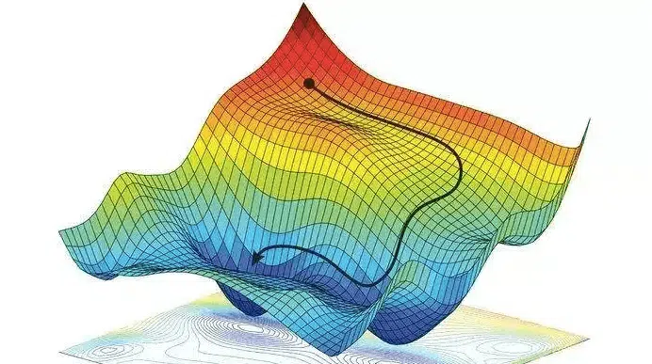
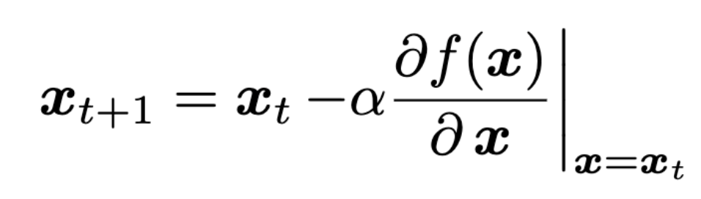
Gradient descent (GD). Iterative updates
If we have a function f(x) and
we want to find x* that correspond to a minimum of f(x),
we can use GD to iteratively approach this x*
gradient at the current x
next x
current x
update step magnitude

Slide 3
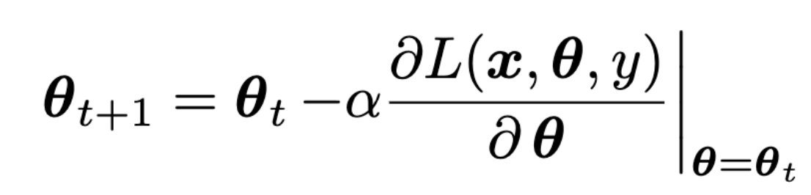
Gradient descent in ML
Our function f(x) is a loss function L(x, θ, y)
θ are weights
x are features, y are labels
gradient of the loss w.r.t. weights
next weights
current weights
learning rate

Slide 4
Previously on MLBBQ

Slide 5
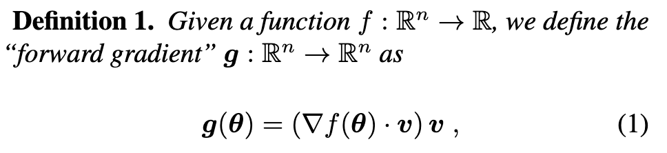
Forward grad – a method to compute gradients
v is a random vector of n components
v_{i} are randomly sampled from
a distribution with 0 mean and 1 variance

Slide 6
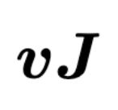
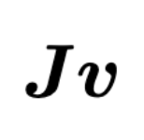
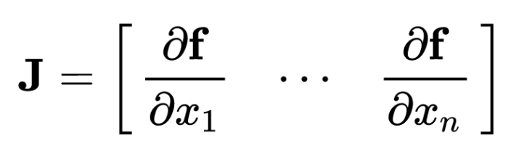
Automatic differentiation (AD) exists in 2 modes
Reverse mode - backpropagation
computes vector-Jacobian product for the given v
in ML error function typically returns a single scalar value → we can calculate the whole gradient in a single pass
Forward mode - Forward grad
computes Jacobian-vector product for the given v
single pass of forward AD is typically faster than a pass of reverse AD
but to compute the exact gradient, it needs to be repeated for every weight i using a different v

Slide 7
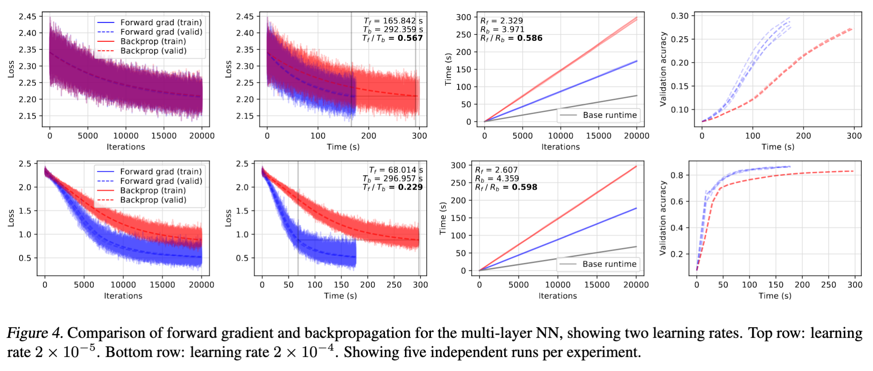
Results. Forward grad is fast and efficient

Slide 8
Issues

Slide 9
Issues
Seems like nobody was able to reproduce these results.
usually forward grad is worse than backprop
Theoretically it should be inefficient for neural networks (too many parameters).
the cosine similarity of the true gradient and the Forward grad acts as O(1/√N), where N is the number of dimensions (weights)
effectively Forward grad is almost orthogonal to the true gradient when used in neural networks

Slide 10
So, what can fix it?

Slide 11
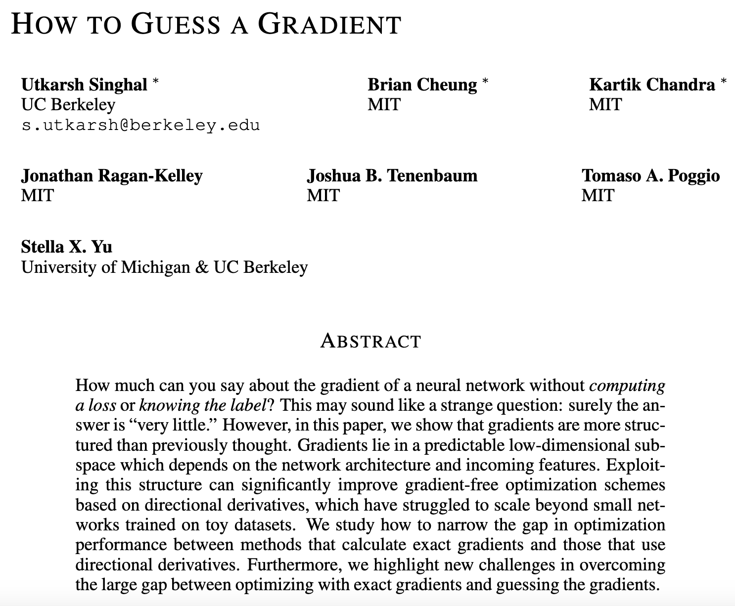
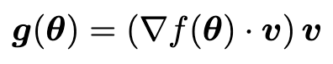
Here the paper starts
The authors of this paper investigated ways to improve the convergence of the gradient descent with Forward grad.
Mainly, they explore the ways to make a better guess of v

Slide 12
What did they come up with? Notation
Let us consider an k-layer MLP with n neurons on each level.
W_{i} are weights of the i-th layer,
x_{i} ∈ R^{n} are incoming activations on the i-th layer,
s_{i} = W_{i} x_{i} are pre-activations, s_{i} ∈ R^{n}
x_{i+1} = ReLU(s_{i}) are outgoing activations

Slide 13
Insight 1. Properties of the architecture
Suppose we want to estimate ∂L/∂W_{i} ∈ R^{nxn}. Let’s expand this derivative using the chain rule:
∂L/∂W_{i} = ∂L/∂s_{i} · ∂s_{i}/∂W_{i}= ∂L/∂s_{i} · ∂W_{i}x_{i}/∂W_{i} = ∂L/∂s_{i} · x⊤_{i}
x⊤_{i} ∈ R^{n} is known during the forward pass
we can guess ∂L/∂s_{i} ∈ R^{n}
it is less dimensional than ∂L/∂W_{i} ∈ R^{nxn}, so we can make less guesses, combine it with x⊤_{i} and get the estimate of ∂L/∂W_{i}

Slide 14
Insight 2. Properties of the ReLU
Let’s unfold the ∂L/∂s_{i} from the previous slide:
∂L/∂s_{i}= ∂L/∂x_{i+1}· ∂x_{i+1}/∂s_{i} = ∂L/∂x_{i+1} · ∂ReLU(s_{i})/∂s_{i}
∂ReLU(s_{i})/∂s_{i} is a diagonal matrix. We can expect that the diagonal is also fairly sparse, and it can be computed during the forward pass.
Based on ∂ReLU(s_{i})/∂s_{i}, we can make better guesses on ∂L/∂x_{i+1}.

Slide 15
Insight 3. Properties of the architecture (again)
Let’s unfold the ∂L/∂x_{i+1} from the previous slide:
∂L/∂x_{i+1} = ∂L/∂s_{i+1} · ∂s_{i+1}/∂x_{i+1}= ∂L/∂s_{i+1} · ∂W_{i+1}x_{i+1}/∂x_{i+1}= ∂L/∂s_{i+1}· W⊤_{i+1}
W⊤_{i+1} is known during the forward pass. It is also most-likely low-rank.
Hence we can guess all n components of ∂L/∂s_{i+1}, but W⊤_{i+1} will effectively reduce their number to the rank of W⊤_{i+1}.

Slide 16
Summing up.
We started with having to guess n² components of the ∂L/∂W_{i} ∈ R^{nxn}.
We are left with the expression for ∂L/∂W_{i}:
∂L/∂W_{i} = ∂L/∂s_{i+1} · W⊤_{i+1} · ∂ReLU(s_{i})/∂s_{i} · x⊤_{i}
We have to guess only ∂L/∂s_{i+1} (n components), the rest of the terms are known during the computation.
Some of these components will be canceled by the derivative of ReLU
Others will be canceled by W⊤_{i+1}

Slide 17
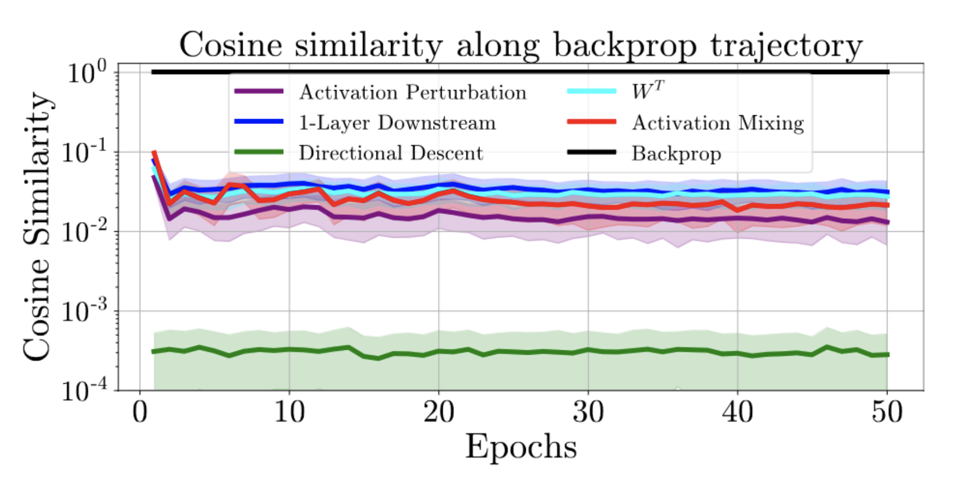
This method is called W^{T}
Let’s see how well it estimates the true gradient.
It does much better than the simple Forward grad.
It is not as good as backprop.

Slide 18
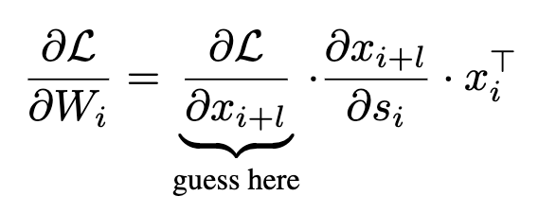
They also considered other methods
Partial backpropagation: a generalization of W^{T}, but without the last step:
instead of guessing locally, in partial backprop we make a guess on the downstream activations (+ l layers deeper);
then we unwrap it using backprop.
It works best when l = 1, so it is further called a 1-layer downstream

Slide 19
They also considered other methods
Activation perturbation: W^{T}, but only with the first step:
∂L/∂W_{i} = ∂L/∂s_{i} · ∂s_{i}/∂W_{i}= ∂L/∂s_{i} · ∂W_{i}x_{i}/∂W_{i} = ∂L/∂s_{i} · x⊤_{i}

Slide 20
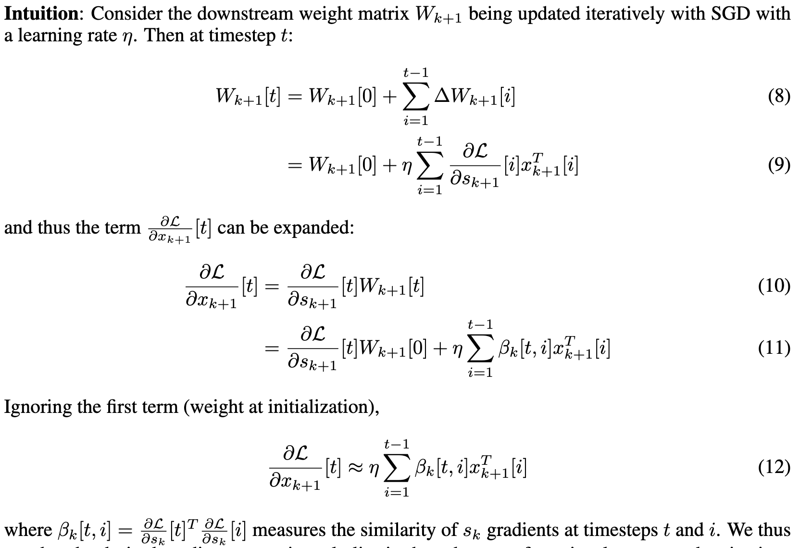
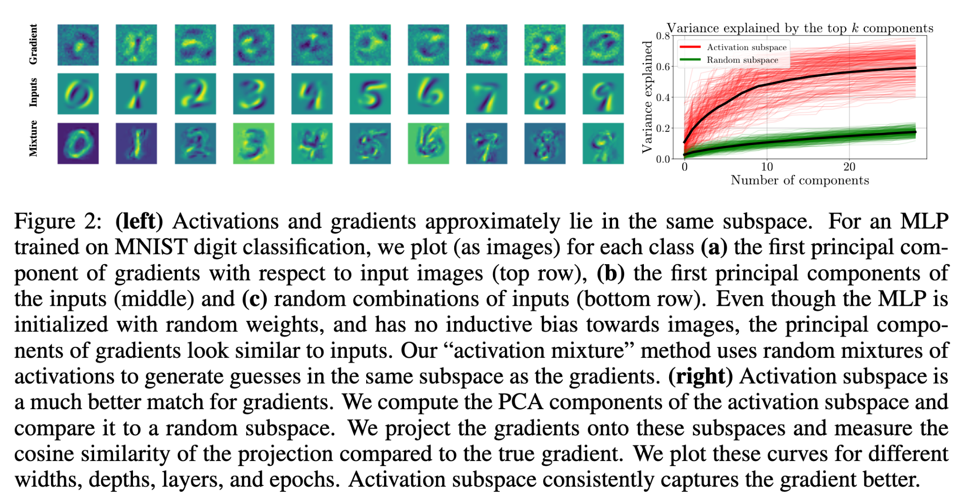
They also considered other methods
Activation mixing: W^{T} which estimates the last step, ∂L/∂x_{i+1}, differently: it guesses it in the space formed by activations x_{i+1} from the previous GD iterations.

Slide 21
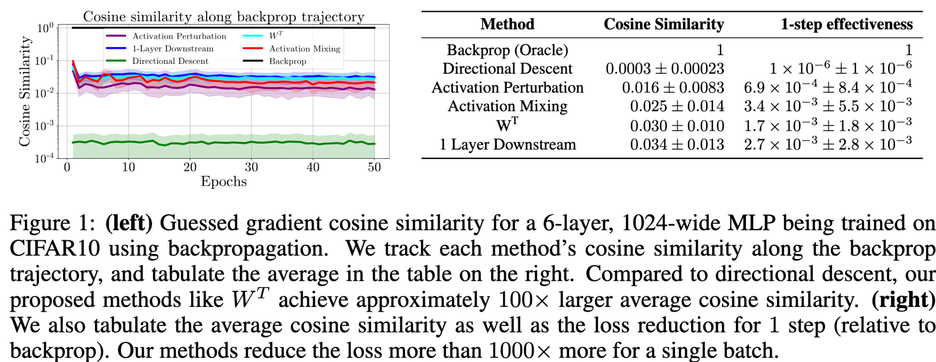
Results. Cosine similarity with the true grad is great

Slide 22
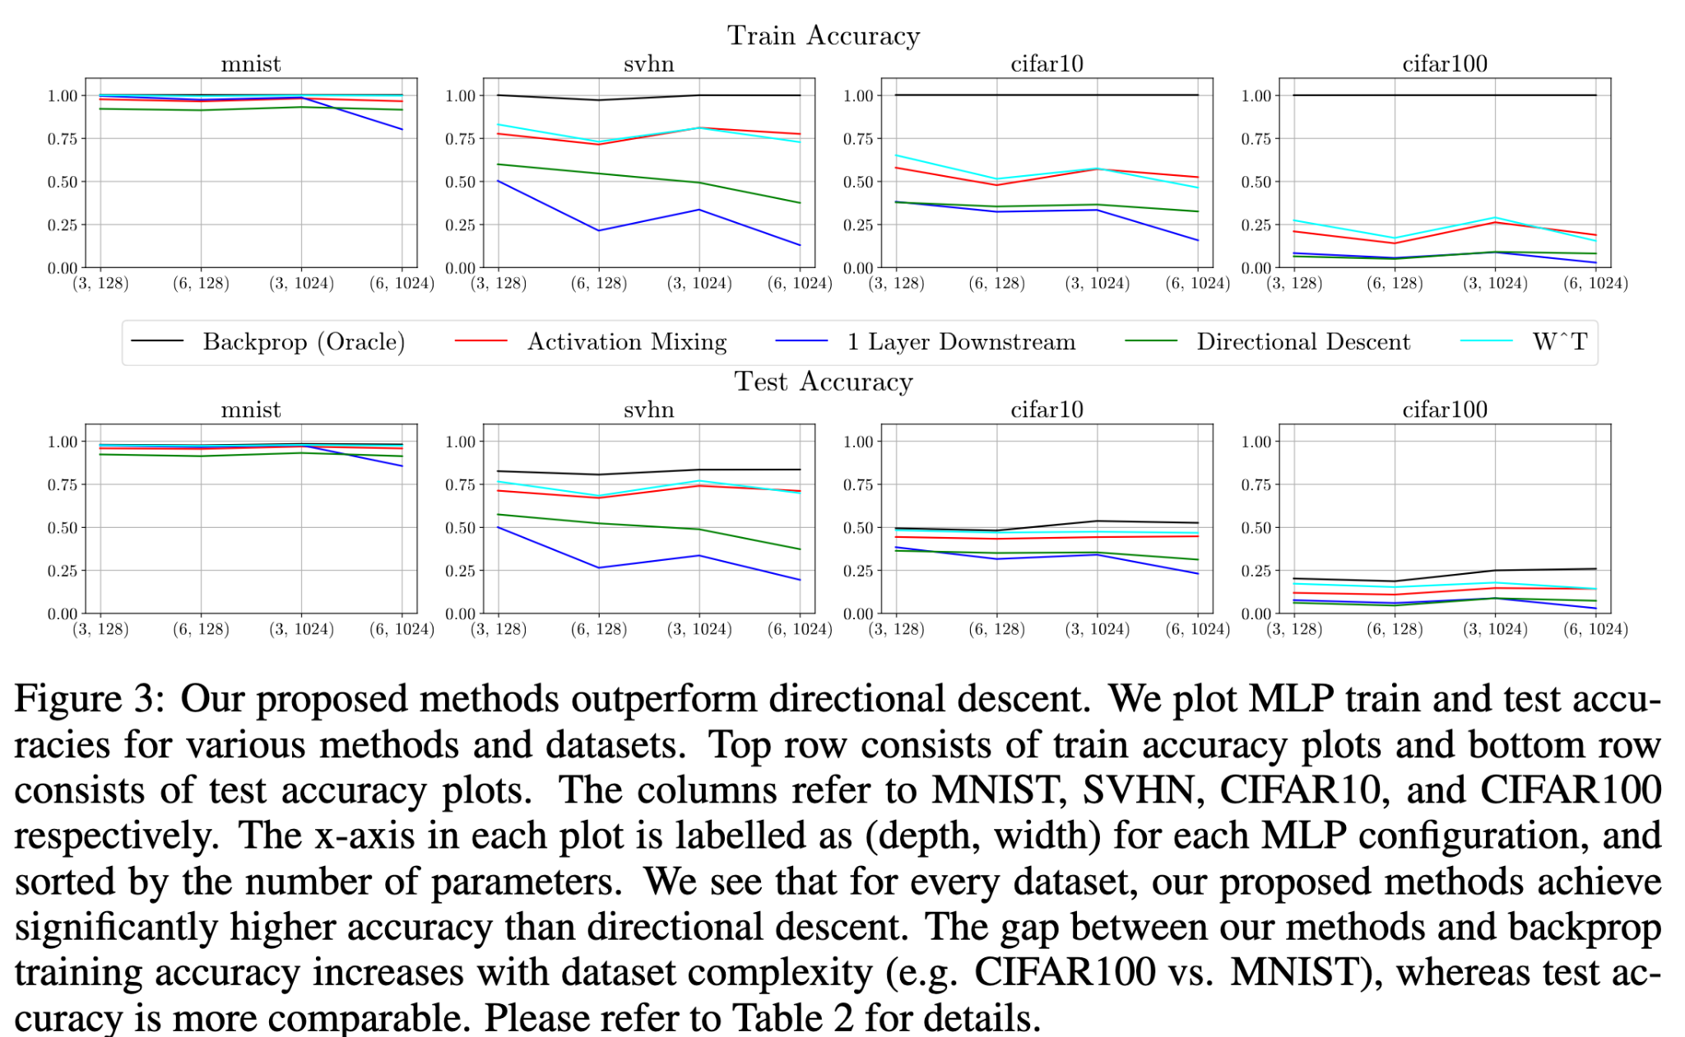
Results. Classification accuracy

Slide 23
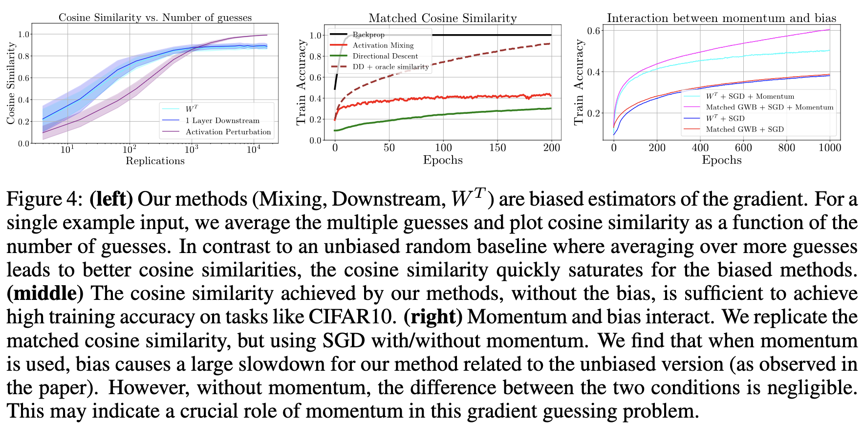
Results. Bias, cosine similarity, momentum

Slide 24
Results. Bias
The proposed method is biased
Backprop is unbiased
Forward grad is unbiased

Slide 25
Results. Cosine similarity
When Forward grad’s cosine similarity is artificially matched to that of W^{T}, it approaches the 100% train accuracy
W^{T} and similar methods can’t do it, probably due to the bias

Slide 26
Results. Momentum
Momentum affects biased and unbiased estimators differently

Slide 27
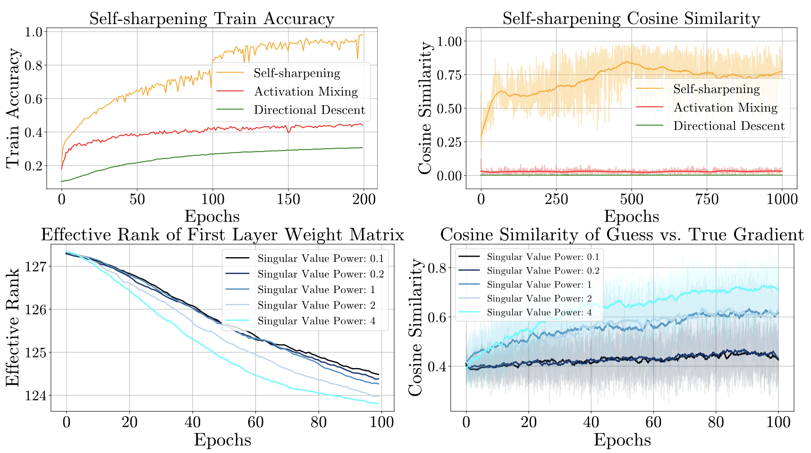
Results. Self-sharpening

Slide 28
Results. Self-sharpening
W^{T} improves its convergence over time
But it also hurts the model generalizability.

Slide 29
Results. Self-sharpening
W^{T} improves its convergence over time
But it also hurts the model generalizability.

Slide 30
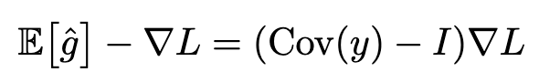
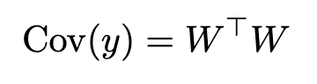
Results. Bias again
General case
W^{T} improves its convergence over time
But it also hurts the model generalizability.
W^{T} case

